Slide 1
Exceptions
When Good Code Goes Bad
06-16-2014

Slide 2
Analysis
Object-orientation is all about recognizing the different “actors” at work in the system being modeled.
First, the different data available within the system are organized appropriately.
Secondly, functionalities relating to the state of data and its management are bound to that data.

Slide 3
Analysis
Object-orientation is all about recognizing the different “actors” at work in the system being modeled.
These objects (“actors”) may then interact with other objects through well-formed, bounded relationships.

Slide 4
Analysis
Constraints: should our object have limitations imposed on it, beyond those implied by the language we’re using?
Some of our internal state variables (fields) may allow values which make no sense in the context of what our object represents.

Slide 5
Encapsulation
In a previous lecture, we built a “Person” class with well-defined states and behavior.
This involved setting up accessor and mutator methods to ensure the object held a logical, valid state.
What we didn’t cover was how an object should behave when something tries to make its state invalid.

Slide 6
A First Object
public class Person
{
private:
const string name;
int age;
public:
Person(string name, int age)
string getName();
int getAge();
void haveABirthday();
}

Slide 7
A First Object
string Person::getName()
{
return this->name;
}
int Person::getAge()
{
return this->age;
}

Slide 8
A First Object
public void haveABirthday()
{
this->age++;
}

Slide 9
Errors
What if someone initializes our class incorrectly? (Bad “input”?)
Naïve solution: be “passive-aggressive.”
To be more technical, we could refuse to change our object for bad inputs.
The problem here is that this is impossible for constructors to do. They must return an instance.
Going passive-aggressive would result in an invalid instance of our object! Not cool!

Slide 10
Errors
A further problem with going “passive-aggressive” is that this gives no indication to outside code that something actually has gone wrong.
It’s left up to outside code to realize that something is amiss… and if this is ignored, it causes strange behaviors later that can get tricky to test for.

Slide 11
Errors
What we’d really like to do: we’d like to indicate – forcibly, if necessary – that some sort of error has occurred within the program.
This “error” may have happened due to different reasons.
Could be the result of a mistake by a programmer…
Or it could be the result of a mistake by the program’s user.

Slide 12
Errors
Before examining how we can signal that an error has occurred, let’s examine other sources of errors.
For example, dividing an integer by zero is one classic source of an error.
In calculator programs, this could easily be a user’s actual request.

Slide 13
Errors
What usually happens whenever a program has an error?

Slide 14
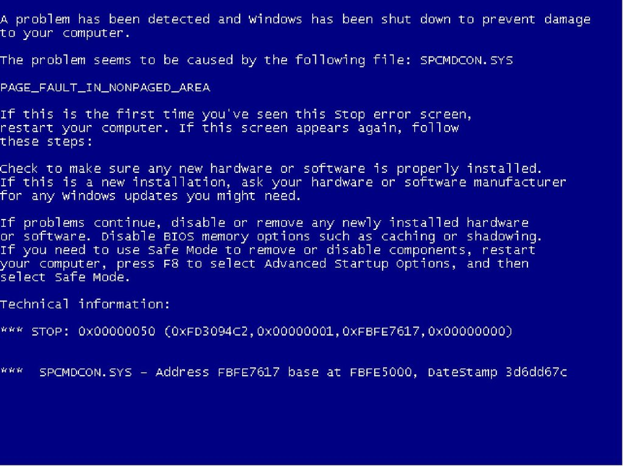

Slide 15

Errors
What usually happens whenever a program has an error?
We’re typically the most familiar with the “crash-and-die” response.

Slide 16
Error Handling
Many programming languages have built-in support for “catching” errors that occur.
This allows programs to attempt a graceful recovery…
Or to crash to the desktop safely instead.

Slide 17
Error Handling
One mechanism used for signaling an error is that of the exception.
The exception operates by interrupting the standard flow of a program by jumping to specialized code for correcting the error.
Note that once an error is encountered within a line of code, it is not safe to evaluate the lines after it, as they may be affected by the error.

Slide 18
Error Handling
In hardware, this is accomplished through something actually known as an interrupt.
Interrupts cause the CPU to cease evaluation of a program temporarily to handle something time-sensitive.
In a sense, CPUs have A.D.D. in regard to interrupts.
There are mechanisms in place to resume operation properly, however.

Slide 19
Error Handling in C++
Within C++, many such exceptions are represented by a form of the std::exception class.
Use #include <stdexcept>.
In particular, most object-oriented exceptions are represented this way.
Other sorts of errors (e.g. arithmetic) may not be represented this way.
Note – these are “object” exceptions.
Notes:
Interrupts:
-Hardware – interrupts - externally generated by hardware
-software level – signals – system –externally generated by other process
-code- exception - internally generated

Slide 20
Error Handling in C++
Exceptions, once thrown, must be caught by specialized error-handling code.
If an exception goes uncaught, the program will crash to the desktop.

Slide 21
A First Object
#include <stdexcept>
Person::Person(string name, int age)
{
if(name.compare(“”) == 0)
{
throw invalid_argument
(“Name may not be null!”);
}
...

Slide 22
A First Object
Person::Person(string name, int age)
{
...
if(age < 0)
{
throw out_of_range
(“Age must be non-negative!”);
}
...

Slide 23
Error Handling
Many of C++’s built-in classes (especially those in the std namespace) are designed to throw exceptions when errors occur.
Examples:
exception
runtime_error
range_error

Slide 24
Throwing Exceptions
For a class to signal an error, it can create an instance of the appropriate exception type and then throw it.
Exceptions often may take on a message, in string form, which can be useful for debugging purposes.
See section 5.6

Slide 25
A First Object
Note that whenever the constructor throws an exception that isn’t handled internally, it cancels the construction process.
Constructor problem solved!

Slide 26
Error Handling
The general structure for handling an error that has occurred:
try {
… useful code
throw exception();
… more useful code
} catch (exception e1){
//Fix the error!
} catch (exception e2){
//Fix the error!
}

Slide 27
Error Handling
try {
… useful code
throw exception();
… more useful code
} catch (exception e1){
//Fix the error!
} catch (exception e2){
//Fix the error!
}
“try” this code and see if any errors happen

Slide 28
Error Handling
try {
… useful code
throw exception();
… more useful code
} catch (exception e1){
//Fix the error!
} catch (exception e2){
//Fix the error!
}
If they do, skip the rest of this code and “catch” the error here…
… or here …

Slide 29
Error Handling
try {
… useful code
throw exception();
… more useful code
} catch (exception e1){
//Fix the error!
} catch (exception e2){
//Fix the error!
}
… more code …
If they do,
skip the rest of this code …
“catch” the error here…
… then continue here

Slide 30
Error Handling
try {
… useful code
throw exception();
… more useful code
} catch (exception e1){
//Fix the error!
} catch (exception e2){
//Fix the error!
}
… more code …
… if the error is of this type. (Or one of its subtypes.)
… or here if the error is of this type (or one of its subtypes)

Slide 31
Catch Clause List
There may be one or more catch clauses following the try block
Order matters! Each catch clause exception type will be matched to the exception thrown – if it fits, use it, else go to the next clause
Only one clause is exercised – so go from most specific to most general (subtype to supertype)
If none match, then dig down the stack
Functions are exited along the way
If exception never caught, then terminate!

Slide 32
Error Types
There are actually multiple sorts of errors which can occur within a program and its code.
Compile-time errors: the interpreter / compiler can’t make sense of your code.
Logical errors: the program doesn’t crash, but it behaves differently than intended.

Slide 33
Error Types
There are actually multiple sorts of errors which can occur within a program and its code.
Run-time errors: Errors which crash a program, but were not intentionally generated by programmer code.
Generally, user-generated issues caused by bad inputs. (GIGO, PEBKAC)
When a calculator program is told to divide by zero, if it doesn’t check for illegalness, a runtime error will occur.
Notes:
For the uninitiated, GIGO = “garbage in, garbage out.” If you give a computer terrible input, it’s going to give you terrible output.
PEBKAC – “problem exists between keyboard and chair.” I’ll let you connect the dots here.

Slide 34
Error Types
There are actually multiple sorts of errors which can occur within a program and its code.
Generated errors: the program detects that it is malfunctioning and generates an error to signal it.
Often generated to prevent run-time errors from crashing the program. Making these gives a chance for recovery if they are caught elsewhere.

Slide 35
Error Types
When a program hangs (goes unresponsive), it’s typically a logical error.

Slide 36
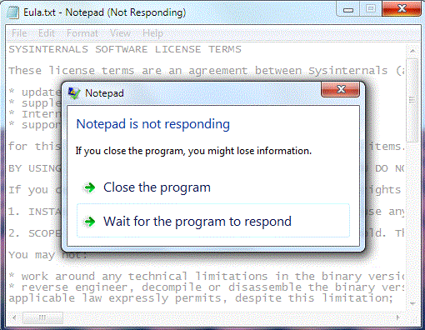

Slide 37
Recovery
Unfortunately, like in the prior example, not all errors can be detected.
Sometimes, an application can get stuck in an infinite loop, rendering it completely unresponsive.
Multithreaded applications can also become stuck due to “deadlock” and “livelock” situations.
Notes:
For the curious, it’s a NP-hard problem (or is it NP-complete?) to detect whether or not a program can even be guaranteed not to hang! Thus, it’s effectively impossible to guarantee that “hangs” can’t happen.
It’s not true, but let’s say that NP effectively means “not possible in polynomial time.” (As in, requires, at least, exponential time to solve. Ouch.) To be most precise, it means “non-deterministic polynomial-time”, but that’s a mouthful and will require a lot of mathematics and more advanced computer science to explain. We’re not going there in this class. (It requires time complexity, something we’ll see only in passing much later. COT 3100 will cover it better than I will, most likely. I’m just giving an intro.)

Slide 38
On the Use of Exceptions
Exceptions are extremely handy to have as a tool for an object to indicate bad inputs to its constructor or method.
However, exceptions are quite “expensive”, computationally, to throw.
Remember, they interrupt everything.

Slide 39
On the Use of Exceptions
Objects should throw exceptions when:
A constructor receives (bad) inputs that would result in an invalid object.
A method receives bad input
Out of range index or value
Null pointer

Slide 40
On the Use of Exceptions
Objects should throw exceptions when:
A method cannot perform the requested action.
Some objects may have different “modes,” where certain actions may only be possible in certain situations.
Example: a file must be opened to read or write from it.

Slide 41
On the Use of Exceptions
Objects should throw their own exceptions, rather than relying on a future method to throw exceptions.
When debugging, it is better to know the underlying source of the erroneous error.
Thus, the sooner code can detect that an error will occur (even if later in the chain), the better.

Slide 42
On the Use of Exceptions
Objects should throw their own exceptions, rather than relying on a future method to throw exceptions.
Failure to do so will make it seem as if the object is miscoded, using the future method incorrectly.

Slide 43
On the Use of Exceptions
Exceptions are a useful tool for object-orientation, allowing objects to actively prevent actions that would be invalid.
They also allow objects to report why those actions are invalid, which aids debugging.
Sometimes, it may even be possible to recover from the error, depending on its type.

